Slide 1
Cloud Based CBM Solutions

Slide 2
Vision Statement
Creating a cloud base integrated solution for the industry in order to achieve real time machine diagnostics and prognostics to have complete predictive maintenance based programme for your factory.

Slide 3
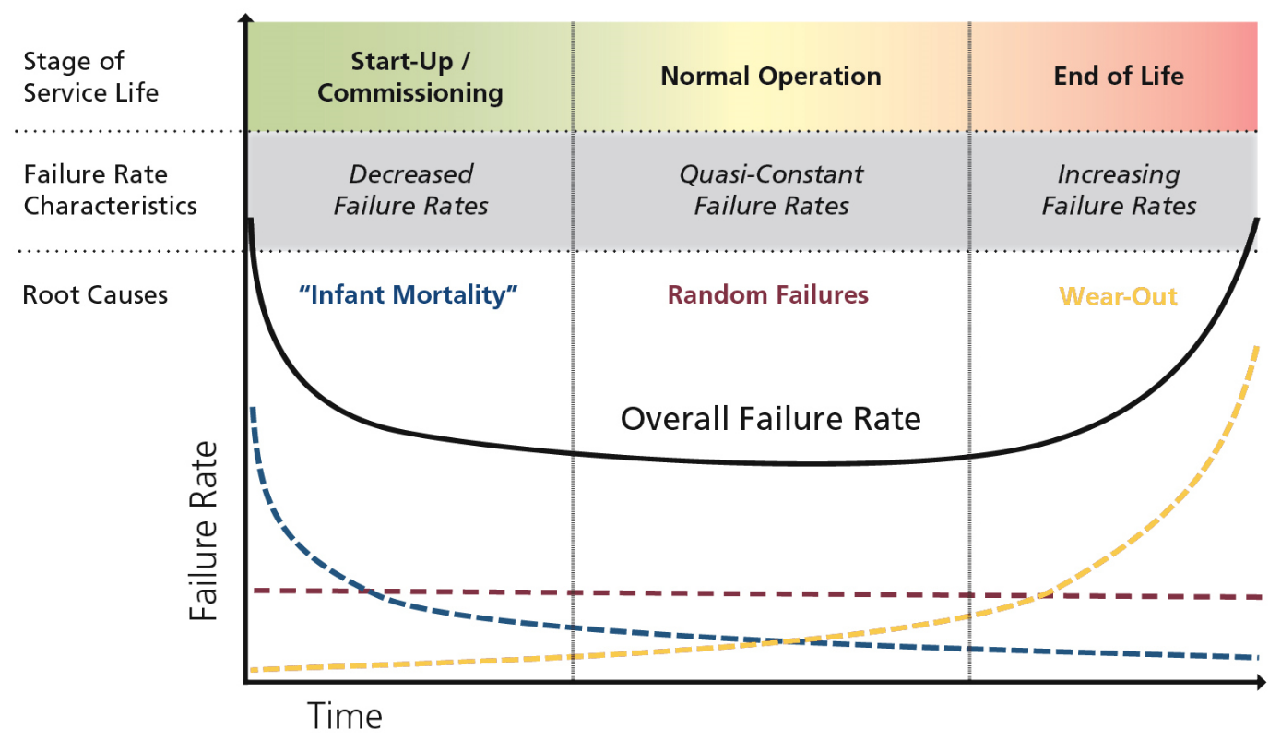
Machine failure in Industry

Slide 4
Maintenance Programmes
Reliability Centred Maintenance
Condition Based Maintenance
Preventive Maintenance
Run To Failure
Predictive Maintenance
Real Time Monitoring

Slide 5
Reliability Centred Maintenance
Preventive Maintenance: Similar to the regular services of our vehicles, preventive maintenance of any equipment is a deliberate downtime as per the predefined preventive maintenance schedule of the equipment(weekly/fortnightly/monthly) following a certain predetermined task list so as to keep the equipment up and running till next PM.
Run To Failure: As the name suggests, RTF is the maintenance programme where the equipment is allowed to run till it’s failure to perform. RTF is the most basic maintenance programme and used in small scale industries where a dedicated maintenance programme would not be economical.
Condition Based Maintenance: CBM is a maintenance technique used to actively manage the health condition of equipment in order to optimize maintenance by performing maintenance only when it is needed and at the most opportune times, thus improving overall system and equipment availability and safety while decreasing operating costs.

Slide 6
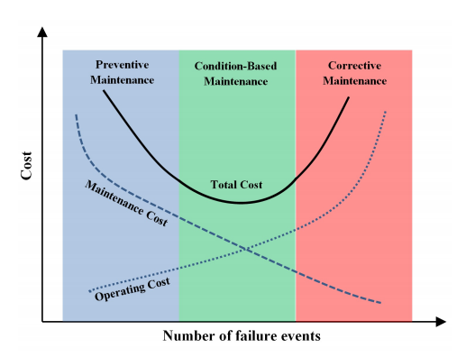
Total Cost as per different maintenance programme under RCM
Reduction In Total Cost considering both operational and maintenance expenditure

Slide 7
CBM ELEMENTS AND TECHNIQUES
CBM is a failure management strategy for a particular failure mode that meets criteria such as:
The potential failure is clearly defined
Failure interval is identifiable
The maintenance task interval is less than the failure interval and physically possible.
The time between the discovery of the potential failure and the occurrence of the function failure is long enough for the maintenance action to be taken to avoid, eliminate, or minimize the consequences of the failure mode

Slide 8
Elements Of CBM
RTM (Real Time Monitoring): RTM monitoring is based on the idea that equipment can be evaluated while remaining in service, which will drive down the overall cost of maintenance.
The valid candidate for RTM must satisfy both the following criteria:
1. Equipment must be critical or expensive enough to warrant the cost, purchase and installation, of monitoring hardware and software.
2. Analysis of the parameters monitored must provide meaningful diagnostics and prognostics.

Slide 9
Elements Of CBM
PdM (Predictive Maintenance): PdM is nothing but the act of taking informed decisions based on monitoring of various parameters which would have rather been based on expert opinion.
Predictive maintenance might include various statistical tools based on the data collected during the real time monitoring and might be able to predict the failure before it actually unfolds.

Slide 11
PM Vs. CBM
Whereas PM addresses age-dependent failure probabilities, CBM addresses failures that can be measured by one or several indicators. When applying maintenance efforts (people, processes, and tools) in a CBM environment, maintenance is based on the actual condition of the equipment versus the age of the equipment, so that equipment in good condition does not need to be maintained as frequently as equipment that has reached the predicted age of deterioration.
The core of CBM is using test equipment or statistically modelling data to predict the condition of equipment. The vision of the CBM application is to enable equipment to achieve nearly zero breakdowns. This will transform traditional maintenance practices from RTF to PdM and prevention of failures. CBM utilizes failure history to predict breakdowns before they happen to prevent future failures from occurring in the field where repairs are costly and operations are impacted.

Slide 12
General components of CBM
CBM involves (not exclusively), vibrational data of the machine, thermal data, oil analysis, pressure analysis and load analysis etc.
All these data, not exhaustively, are collected and analysed individually in order to provide a condition based monitoring and maintenance programme to a factory.

Slide 13
Our Solution

Slide 14
Cloud Based CBM Solution
Our solution involves creating a cloud based meshed network of all the equipment in a particular factory. This cloud based network would be able to host the real time data, as well as the test algorithm for all the sensors.
The analysis of this data would be done in real time on cloud server itself and live dashboards would be accessible via mobile application, which would also receive notifications for approaching failures. This data after crossing a certain threshold will enable us to predict failures well in advance for the machine by using the AI based predictive techniques.

Slide 15
Cloud Based CBM Solution
Analog data collection from the sensors with date stamping
Amplification/attenuation if required
Anti-aliasing
ADC Conversion
Data Transmission To cloud
Data processing as per the algorithm
Data storage on the cloud
Updating of real time dashboards in the mobile application
Sending notifications in case of approaching failures

Slide 16
Approach for the solution
FMEA of the critical equipment or as per client requirement
Failure frequency historical data compilation as per different subsystems
Planning for installation of CBM, degree depending on the criticality of the subsystems.
Programming, Data collection and server hosting at client premises and setting up with their Wi-Fi protocols
Installation of respective sensors and subsystems specific to client
Beginning of data collection and analysis on the cloud
Testing phase for data collection, mobile notification testing and server testing
Handing over

Slide 17
Proof Of Concept

Slide 18
POC for Lathe/CNC Lathe Machine
In order to prove the concept/part of it, we have decided to create a vibrational analysis based system for failure prediction and identification for a CNC lathe machine.
This solution would involve basic vibrational data collection, transmission, and local FFT analysis of the data.
The data should be able to highlight any dynamic imbalances, lubrication contaminations, plausible bearing failures and misalignments.
This solution should be able to reduce the downtime, increases OEE(overall equipment effectiveness); as availability and quality would both increase, should reduce spare inventory for the machine.

Slide 19
Failure modes and effects analysis

Slide 21
The solution
As the FMEA of the lathe suggests that most of the downtime comes because of failures in headstock corresponding to equipment failure. We would be installing our vibration measuring sensors on the headstock for trial.
For the sake of trial we have chosen Piezo-electric accelerometers rather than strain gauges and eddy current based accelerometers, because of lesser complexity of installation.
These accelerometers are direct contact type and would be in contact with the suitable part of the headstock.
These will be connected to the local Arduino based nodes, which will be connected to the power supply. These nodes will transmit the data in digital format which will be received on a cloud/locally and depending on the FFT (Fast Fourier Transform) analysis tool chosen would devise a frequency domain based result.

Slide 22
The solution
This result should be able to provide us with a frequency domain of the waveform of the subsystem of the equipment.
With help of this frequency data, (which would be having certain spikes at various frequencies), the problem in the machine can be traced back.
Now in order to verify the solution we would first test the lathe machine with perfect lubricant and take the frequency data. This frequency data would be stored.
Now, we’ll deliberately contaminate the lubricant of any bearing. Ideally depending on the contamination at the respective components of bearing, different spikes in vibrational graphs must be observed.

Slide 23
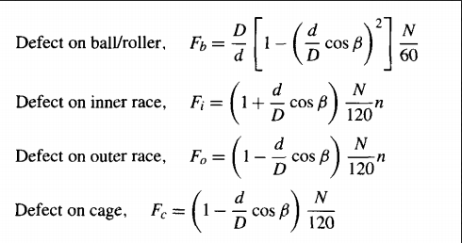
POC validation
Now corresponding to these set of formulas, the exact location of failure in the bearing can be traced back.

Slide 24
POC validation
Now if the vibrations observed corresponds with the formulas, then the sensor data and the algorithm can be validated.
These steps can be repeated similarly for other kinds of analyses as well depending upon the failure modes.

Slide 25
Thank You

